Slide 1
Topic 4: Examining Numerical Data
STOR 155: Introduction to Data Models and Inference
Dr. Teressa Bergland
Fall 2025

Slide 2
Announcements
Course PSAs:
Homework 3 due TODAY, Thursday 1/22 on WebAssign
Homework 4 due Tuesday, 1/27 on WebAssign
IMPORTANT: UCO new system issues
Warm-Up:
Think about something you might want to collect data on. Why does it interest you? What sorts of data would you be collecting?
Share with a neighbor!

Slide 3
Practice Time! True/False
Which of the following statements regarding differences between experiments and observational studies are true?
Experiments take place in a lab, while observational studies do not need to.
In an observational study we only look at what happened in the past.
Experiments use random assignment while observational studies do not.
Observational studies are completely useless since no causal inference can be made based on their findings.
Experiments involve active intervention or treatment, while observational studies are passive.

Slide 4
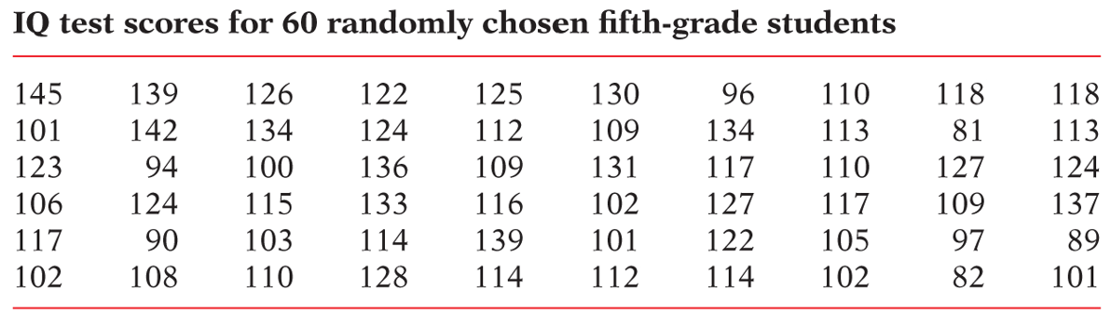
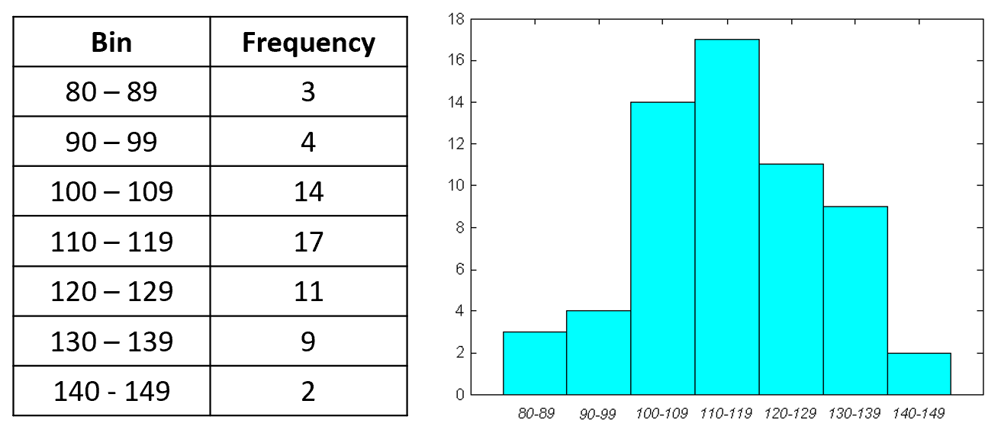
Numerical Data and Histograms

Slide 5
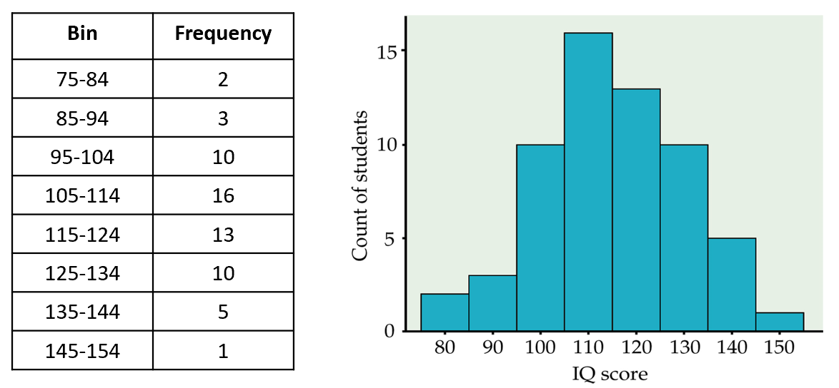
Histograms

Slide 6
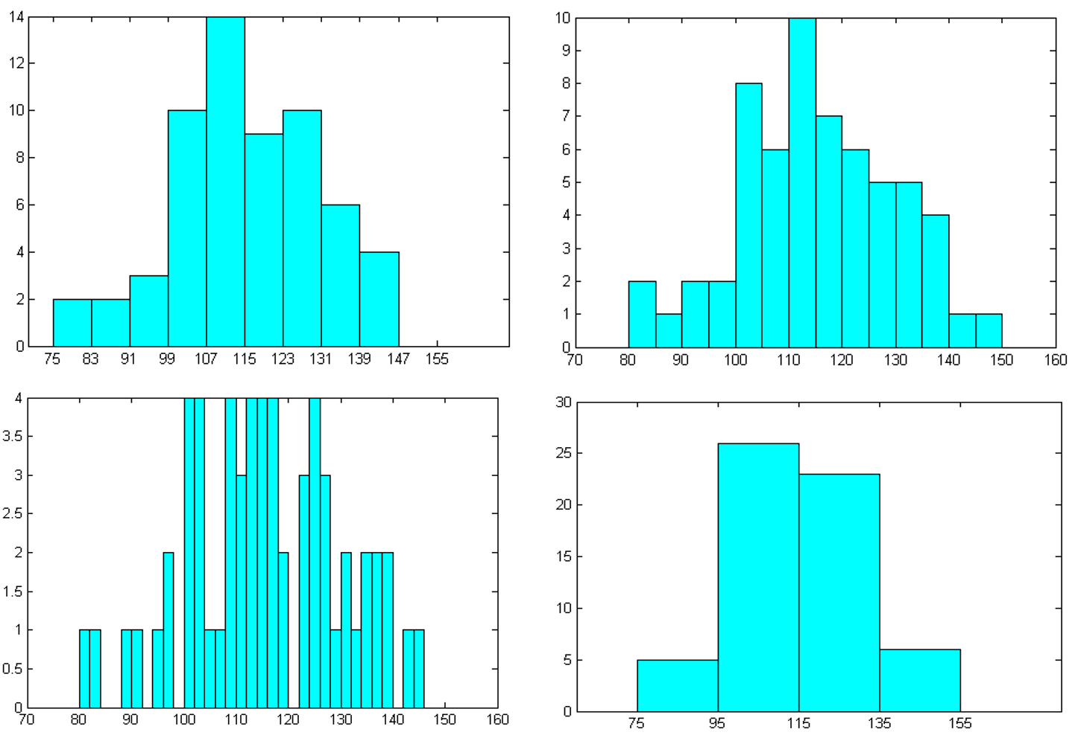
What Belongs in the Bin?

Slide 7
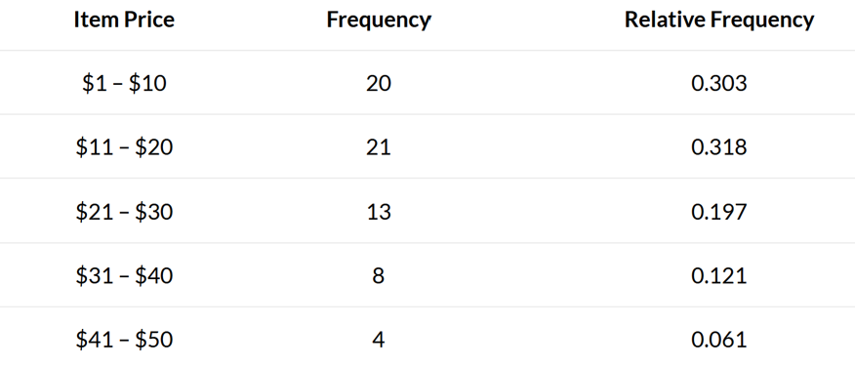
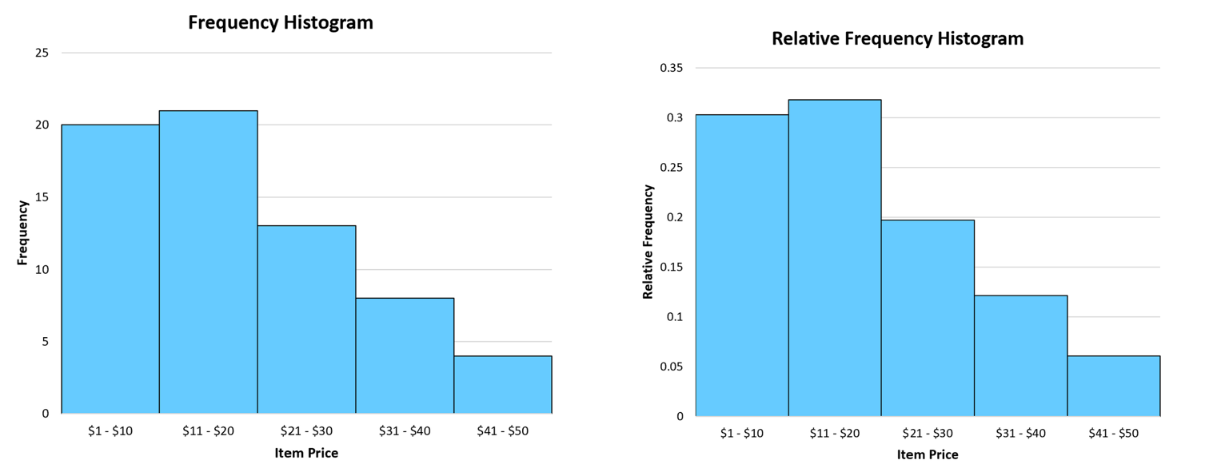
Relative Frequencies

Slide 8
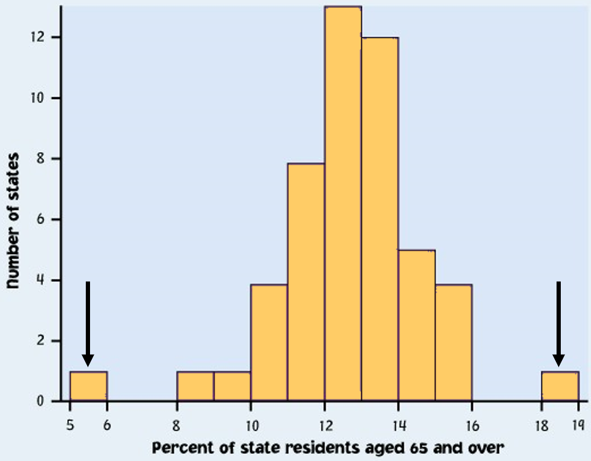
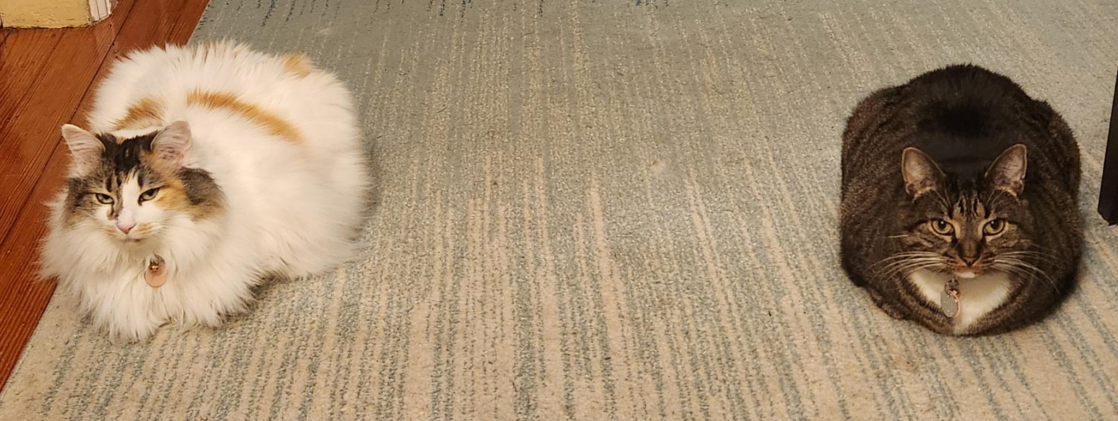
Identifying Outliers

Slide 9
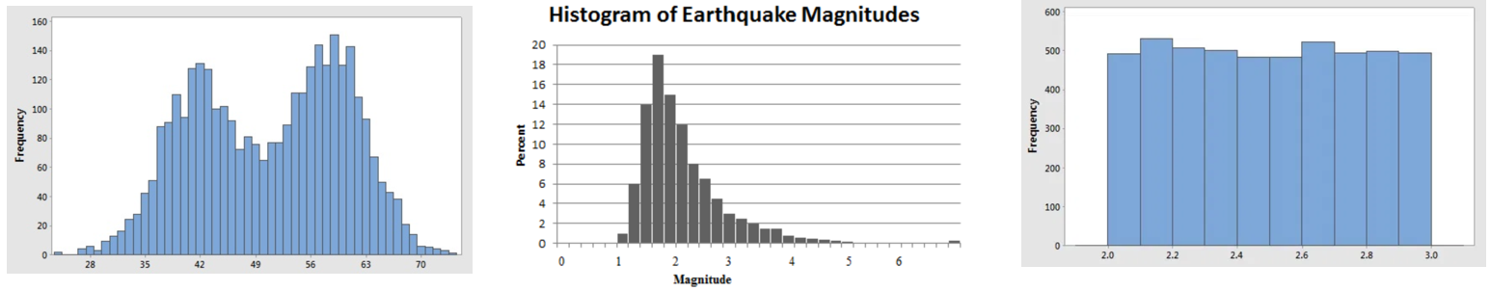
Describing Distributions
4 Key Characteristics:
Shape
Center
Spread
Outliers

Slide 10
Describing Distributions
4 Key Characteristics:
Shape
Center
Spread
Outliers

Slide 11












Birthday Party!
A birthday party has 9 attendees of the following ages:
7, 1, 3, 4, 4, 6, 3, 5, 3
Notation
Measures of Center
Effect of Outliers
…64?

Slide 12
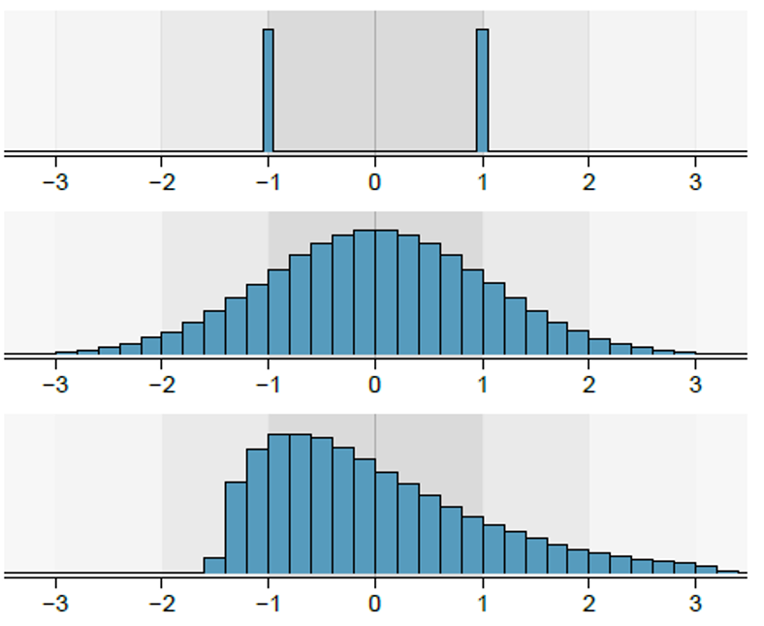
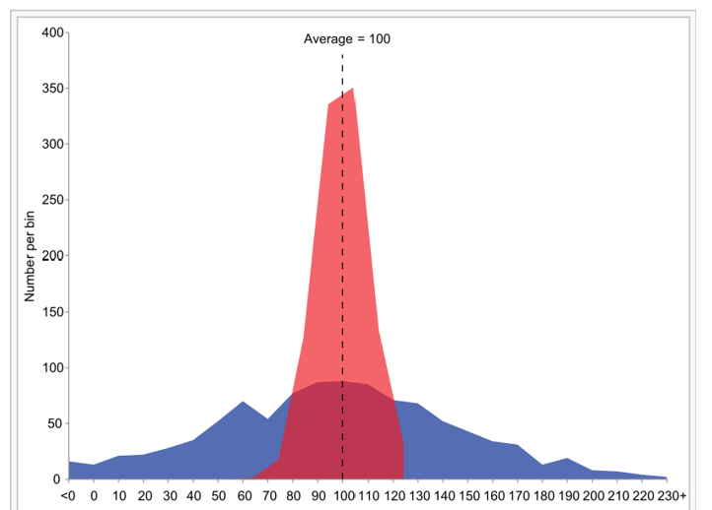
Measures of Spread
A birthday party has 9 attendees of the following ages:
7, 1, 3, 4, 4, 6, 3, 5, 3
Variance and standard deviation

Slide 13
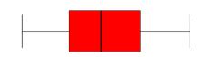

Measures of Spread
A birthday party has 9 attendees of the following ages:
7, 1, 3, 4, 4, 6, 3, 5, 3
Interquartile range (IQR)
Specific criteria for outliers
5-number summary
Box plot representation

Slide 14
Numerical Data and Excel
…I can’t even get a decent screenshot of the data I’m giving you.
VERY USEFUL EXCEL FUNCTIONS:
Mean: AVERAGE(data)
Variance: VAR.S(data)
Standard deviation: STDEV.S(data)
Minimum: MIN(data)
Quartile 1: QUARTILE.INC(data,1)
Median: MEDIAN(data)
Quartile 3: QUARTILE.INC(data,3)
Maximum: MAX(data)

